Slide 1
Uncovering Molecular Adaptations in the Addicted Brain: A Focus on Dopamine Genes and Sex Differences
By Hoang Yen Nhi Nguyen

Slide 2

Addiction is a chronic brain disease involving changes in dopamine signaling.
How Dopamine Normally Works
In the brain, dopamine is a chemical messenger (neurotransmitter) involved in pleasure, motivation, and reward.
Dopamine is released by neurons into a small space called the synapse (a gap between neurons).
Once it delivers its message, dopamine is recycled — it's taken back up into the neuron that released it by a special protein called the dopamine transporter (DAT).
Cocaine
DAT
Hu, M., Crombag, H., Robinson, T. et al. Biological Basis of Sex Differences in the Propensity to Self-administer Cocaine. Neuropsychopharmacol 29, 81–85 (2004). https://doi.org/10.1038/sj.npp.1300301
Notes:
Cocaine addiction is a complex neuropsychiatric disorder that hijacks the brain's reward and motivation systems, particularly the dopaminergic pathways centered in the nucleus accumbens (NAc). Chronic cocaine use elevates synaptic dopamine levels, triggering adaptive molecular and cellular changes that lead to tolerance, craving, and relapse. One of the most consistent findings in addiction neuroscience is the long-lasting dysregulation of dopamine receptor signaling, which varies between males and females.
In this study, we focused on a select group of dopamine-related genes that play key roles in the brain's response to cocaine:
Research suggests that female rodents exhibit faster acquisition of cocaine self-administration and altered dopamine receptor expression, particularly following hormonal changes such as estradiol treatment (Hu, el at., 2004) .These findings highlight the importance of considering sex as a biological variable in addiction studies.
Additionally, the role of dopamine receptor gene variation has been explored in multiple neuropsychiatric contexts, further supporting their central role in behavioural regulation, impulsivity, and substance abuse risk (ScienceDirect Topic Summary on Dopamine Receptor Genes).
By focusing on Cartpt and the Drd1–Drd5 receptor genes, this study aims to evaluate how sex and 28-day cocaine withdrawal influence gene expression in the NAc. These genes offer valuable insight into how the brain adapts to prolonged stimulant exposure and may help explain sex-specific vulnerabilities in addiction.
-------------------
Reference
Zhang L, Lou D, Jiao H, Zhang D, Wang X, Xia Y, Zhang J, Xu M. Cocaine-induced intracellular signaling and gene expression are oppositely regulated by the dopamine D1 and D3 receptors. J Neurosci. 2004 Mar 31;24(13):3344-54. doi: 10.1523/JNEUROSCI.0060-04.2004. PMID: 15056714; PMCID: PMC6730011.
Lohoff, F. W., Bloch, P. J., Weller, A. E., Nall, A. H., Doyle, G. A., Buono, R. J., Ferraro, T. N., Kampman, K. M., Pettinati, H. M., Dackis, C. A., Oslin, D. W., O’Brien, C. P., & Berrettini, W. H. (2008). Genetic variants in the cocaine- and amphetamine-regulated transcript gene (CARTPT) and cocaine dependence. Neuroscience Letters, 440(3), 280–283. https://doi.org/10.1016/j.neulet.2008.05.073
Ozburn AR, Falcon E, Twaddle A, Nugent AL, Gillman AG, Spencer SM, Arey RN, Mukherjee S, Lyons-Weiler J, Self DW, McClung CA. Direct regulation of diurnal Drd3 expression and cocaine reward by NPAS2. Biol Psychiatry. 2015 Mar 1;77(5):425-433. doi: 10.1016/j.biopsych.2014.07.030. Epub 2014 Aug 13. PMID: 25444159; PMCID: PMC4315729.
Hu, M., Crombag, H., Robinson, T. et al. Biological Basis of Sex Differences in the Propensity to Self-administer Cocaine. Neuropsychopharmacol 29, 81–85 (2004). https://doi.org/10.1038/sj.npp.1300301

Slide 3
What Happens with Repeated Use
Over time, the brain adapts
This leads to tolerance, craving, and a cycle of addiction.
The extra dopamine keeps stimulating dopamine receptors on the receiving neuron
— the “high.”
Dopamine receptors may become less sensitive (called desensitization)
The brain may reduce the number of receptors (called downregulation)
Natural dopamine release becomes weaker — making normal pleasures feel less rewarding
Zhang L, Lou D, Jiao H, Zhang D, Wang X, Xia Y, Zhang J, Xu M. Cocaine-induced intracellular signaling and gene expression are oppositely regulated by the dopamine D1 and D3 receptors. J Neurosci. 2004 Mar 31;24(13):3344-54. doi: 10.1523/JNEUROSCI.0060-04.2004. PMID: 15056714; PMCID: PMC6730011

Slide 4

Research Study and Data
Sex-Specific Gene Expression in the Mouse Nucleus Accumbens Before and After Cocaine Exposure
(LaRese et al,. 2019
Subjects: Male and female C57BL/6J mice.
Design:
Mice were divided into 4 main groups:
20 mg/kg of cocaine
10 consecutive days
Saline-treated males
  Saline-treated females
Ovary-removed
Cocaine-treated males
  Cocaine-treated females
withdrawal
28 days
Tissue Collection: Nucleus accumbens tissue was dissected.
RNA-seq Analysis: Gene expression profiling was performed using high-throughput sequencing
Notes:
Cocaine Treatment: Mice received 20 mg/kg of cocaine for 10 consecutive days, followed by withdrawal for 28 days.
Tissue Collection: Nucleus accumbens tissue was dissected on Day 28 post-withdrawal.
RNA-seq Analysis: Gene expression profiling was performed using high-throughput sequencing
Sex-Specific Expression: Females and males displayed distinct gene expression patterns both under control (saline) and cocaine-withdrawn conditions.
Cocaine Effects: Cocaine caused lasting gene expression changes, especially in genes linked to dopamine signaling, synaptic plasticity, and chromatin modification.
Dopaminergic Genes: Genes like Cartpt, Drd1-Drd5, and others were analyzed to explore their role in cocaine's long-term effects.

Slide 5
Research Questions
1. Are there differences in dopamine-associated gene expression between male and female mice?
2. Are there gene expression differences of these genes after 28 days of cocaine withdrawal?

Slide 6
Methods: Gene Selection and Analysis
One of the most consistent findings in addiction neuroscience is the long-lasting dysregulation of dopamine receptor signaling,
which varies between males and females.
Tools: R, tidyverse, ggplot2.
Statistical Test: Linear model (lm) for Sex and Condition effects on expression.
Cartpt (Cocaine- and Amphetamine-Regulated Transcript) is directly activated by cocaine and is highly expressed in the Nac (Lohoff, et al., 2008)
The Drd1–Drd5 dopamine receptor genes -Dysregulation of these genes is linked to altered cocaine sensitivity, withdrawal symptoms, and sex-specific addiction vulnerability (Ozbum, et al., 2015; Zhang L, et al., 2004).

Slide 7
Methods: Dataset and Preprocessing
Dataset: RNA-seq gene expression data from mouse nucleus accumbens.
Preprocessing: Converted to long format, cleaned sample names, and log-transformed expression values.
Groups: Male vs Female, Cocaine-treated vs Naive.

Slide 8
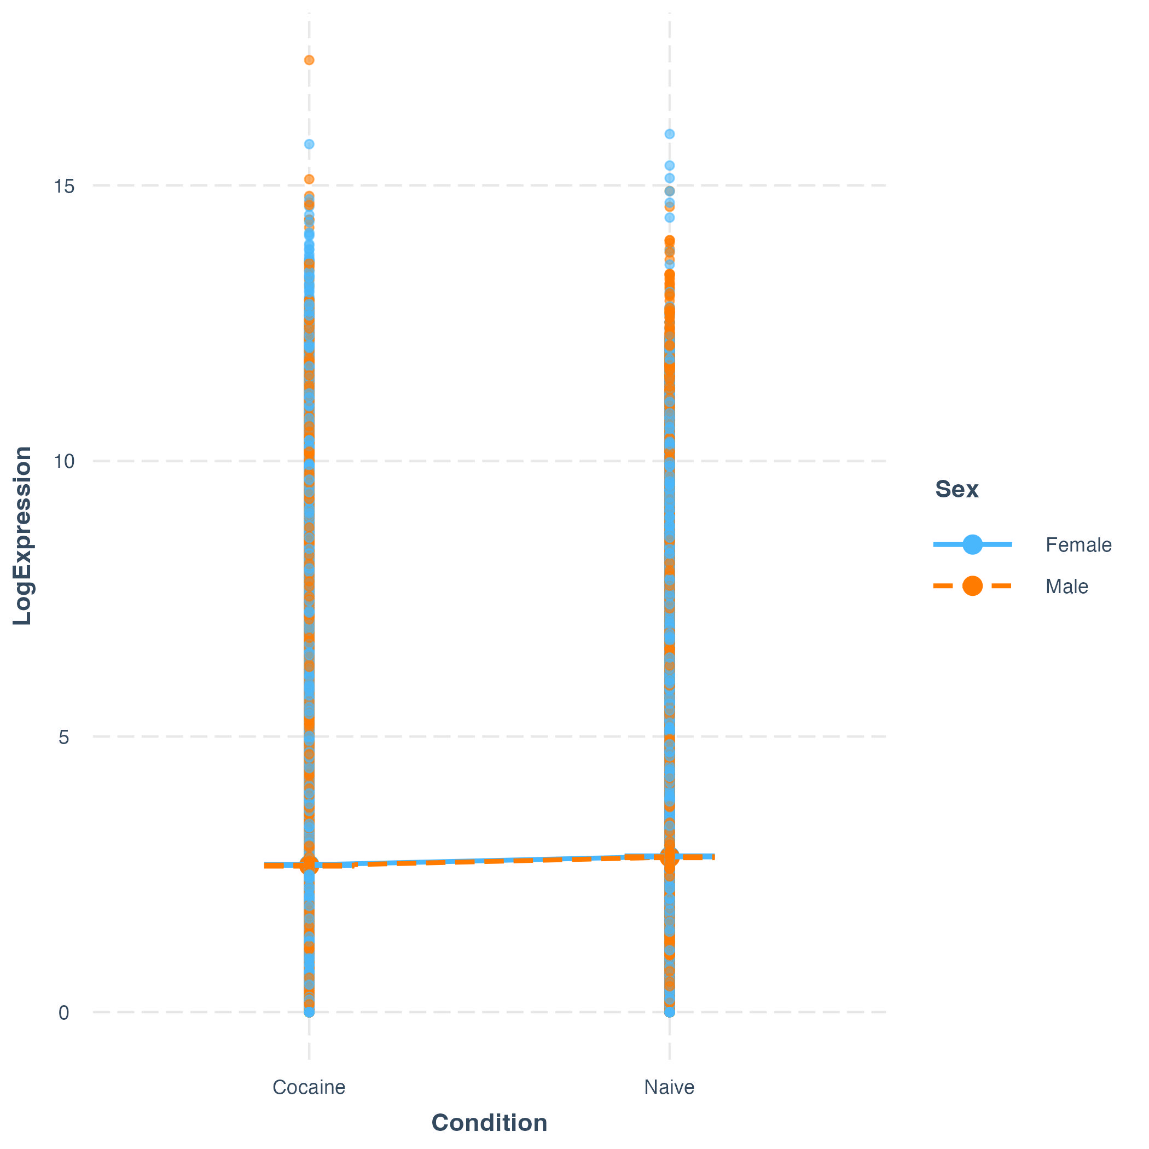
Linear Models: Testing Sex and Condition Effects on Total Gene Expression
Very slight upward trend in Naive group vs Cocaine
→ Indicates that overall gene expression is slightly higher in Naive mice compared to Cocaine-withdrawn mice.
No strong difference between males and females
→ Both sexes show very similar expression distributions in each condition.
Minimal interaction
→ The nearly parallel and flat lines suggest there is no interaction between Sex and Condition. Cocaine withdrawal does not differentially impact males vs. females.
Notes:
We applied three linear regression models to assess the effect of Sex and Condition on gene expression. All models indicated statistically significant effects of Sex and/or Condition. Specifically, male mice had slightly lower expression than females, and Naive mice had slightly higher expression than those exposed to cocaine. However, the effect sizes were extremely small (R² < 0.001 in all models), suggesting that while statistically detectable, Sex and Condition do not explain meaningful variation in global gene expression levels. These findings may reflect subtle differences that become detectable only due to the large sample size, rather than biologically significant changes across the genome.
>The interaction plot shows no clear evidence of an interaction between Sex and Condition on gene expression. Both males and females exhibited similar expression levels across Cocaine and Naive conditions, suggesting no significant effect of sex or drug withdrawal on this gene.

Slide 9
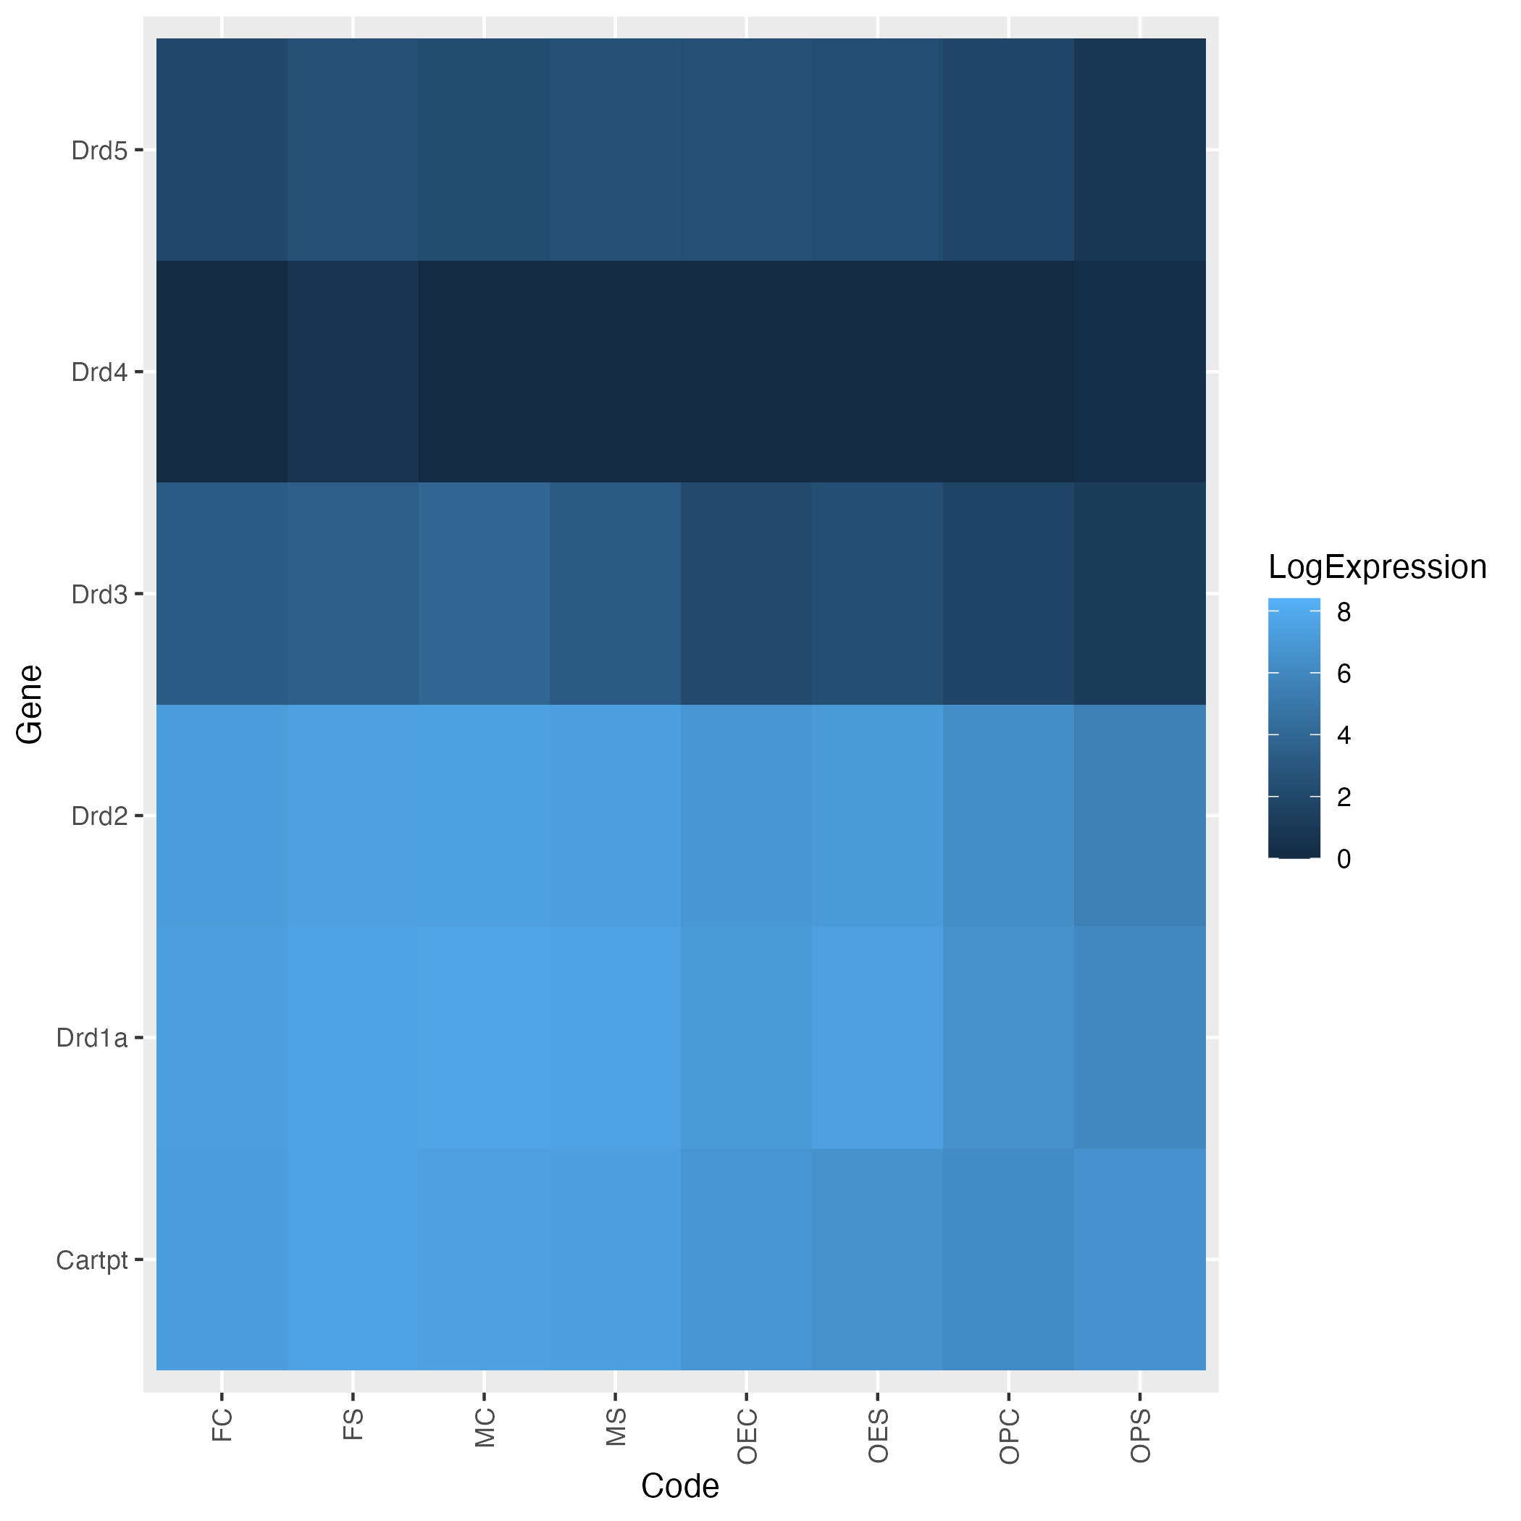
Dopamine-Related Gene Expression
Drd2 and Drd1a show the highest overall expression
Drd3 and Drd4 exhibit lower expression, especially Drd4, which is nearly absent across all groups
No drastic expression shifts across treatment groups, but subtle differences may warrant further analysis
Naive
Cocaine
Notes:
These dopamine genes are differentially expressed in the nucleus accumbens and may contribute to neural adaptations following drug exposure or hormonal changes.

Slide 10
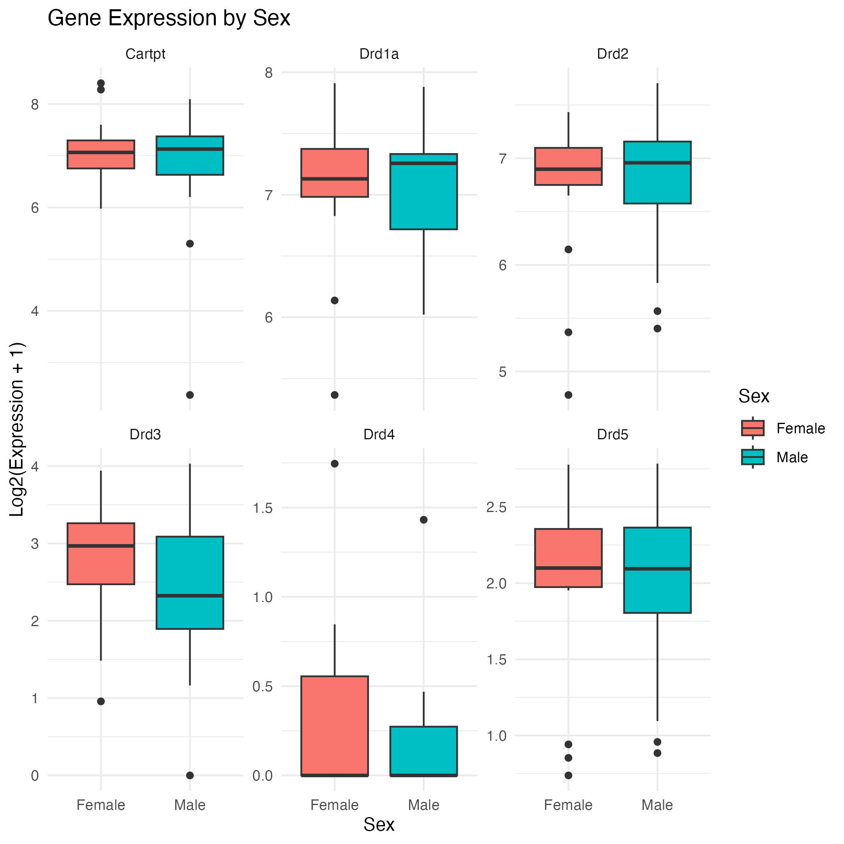
Dopamine Gene Expression by Sex
Cartpt, Drd1a, Drd2, Drd5 show similar expression across sexes
Drd3 shows a mild increase in females, but not statistically significant
Drd4 is expressed at very low levels in both sexes

Slide 11
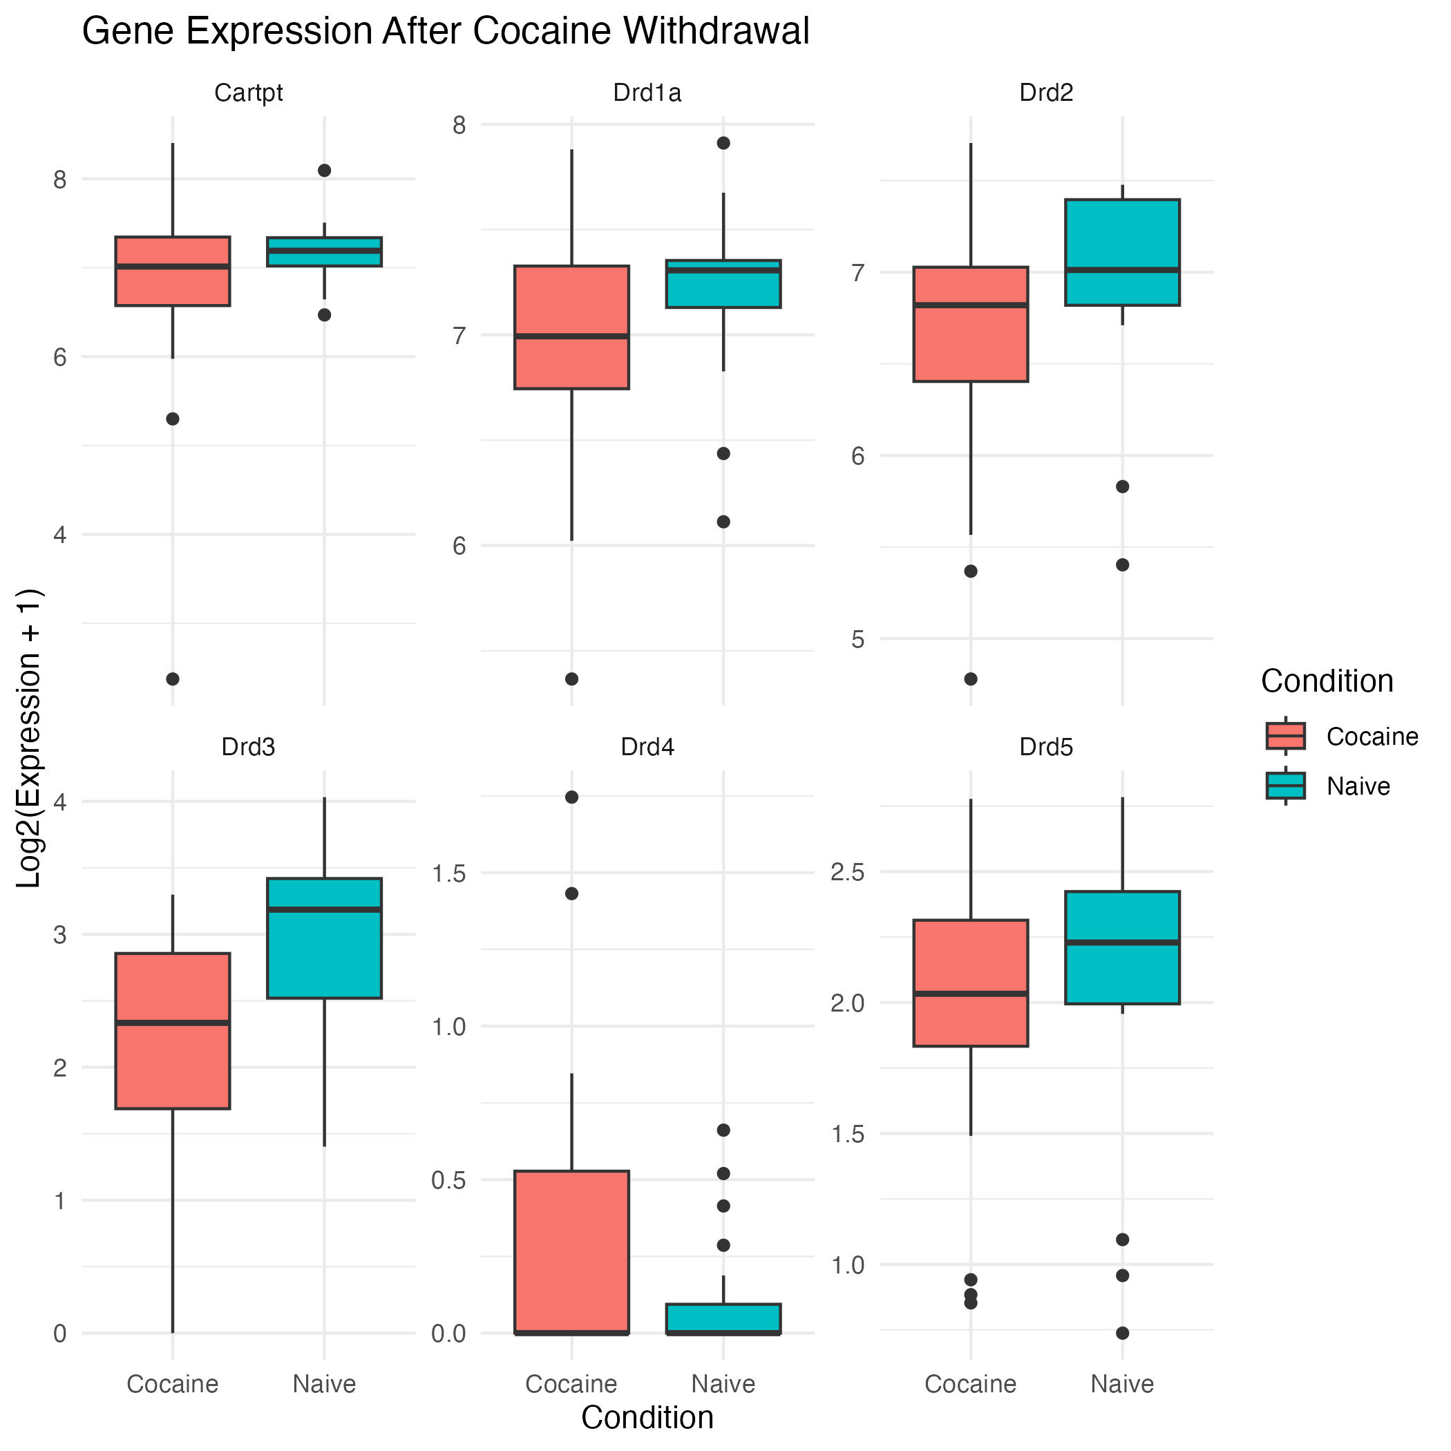
Dopamine-related gene expression differs after cocaine withdrawal
Drd3 shows a significant increase in the Naive group, suggesting cocaine withdrawal suppresses its expression
Drd2 and Drd1a also show reduced levels in the cocaine group
Drd4 is low across all samples, and Drd5 shows mild upregulation in Naive
Cocaine withdrawal appears to suppress dopamine receptor gene expression, particularly Drd3, highlighting its potential role in addiction-related neuroplasticity.

Slide 12
What Does Drd Gene Downregulation Suggest?
• Downregulation of Drd genes suggests lasting neuroadaptation after cocaine exposure.
*Drd1 and Drd3 among genes showing altered regulation post-cocaine
• Lower receptor expression may reflect decreased sensitivity to dopamine and impaired pleasure response.
• This supports the idea that chronic cocaine use causes the brain to adapt by reducing receptor availability, even after withdrawal.
• Downregulation of Drd3, is linked to emotional regulation and drug craving — key aspects of relapse vulnerability.
Notes:
Drd1 and Drd3 among genes showing altered regulation post-cocaine, especially in females

Slide 13
Conclusions and Next Steps
Preliminary findings suggest possible sex and withdrawal effects on dopamine genes.
Drd3 shows trends worth deeper investigation.
Future: expand analysis to more genes, increase statistical power, and explore time-course effects.

